Slide 1
Brain POP
32112191 kim min hwan
32112194 Kim hyo sang
32112215 choi ji soo

Slide 2
context
Embedding Design
Schedule
Game information
Class diagram

Slide 3
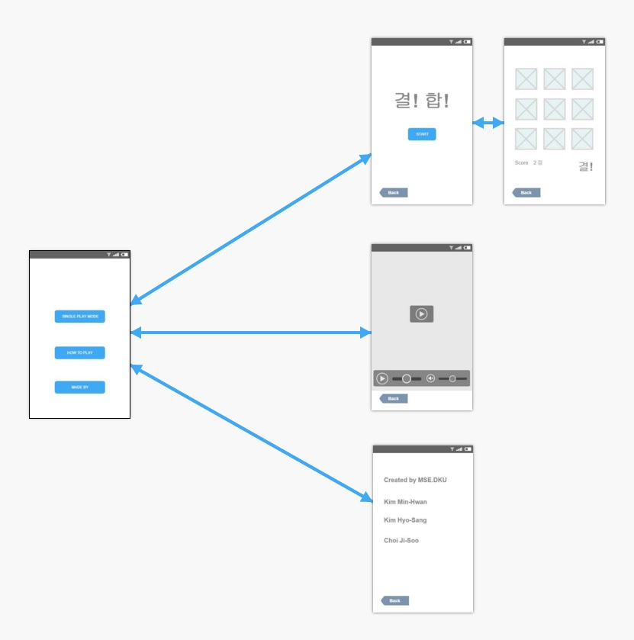
Embedding Design

Slide 4
Schedule
월 | 9월 |  |  | 10월 |  |  |  | 11월
주차 | 3 | 4 | 5 | 1 | 2 | 3 | 4 | 1 | 2 | 3 | 4 | 5
work | idea construction
 |  | Designing
 |  |  |  | Basic implementation
 |  |  |  |  |  | Source attachment
 |  |  |  |  |  |  |  | Game algorithm implementation
 |  |  |  |  |  |  |  |  |  | Error modifing
 |  |  |  |  |  |  |  |  |  |  | Design & algorithm completed

Slide 5
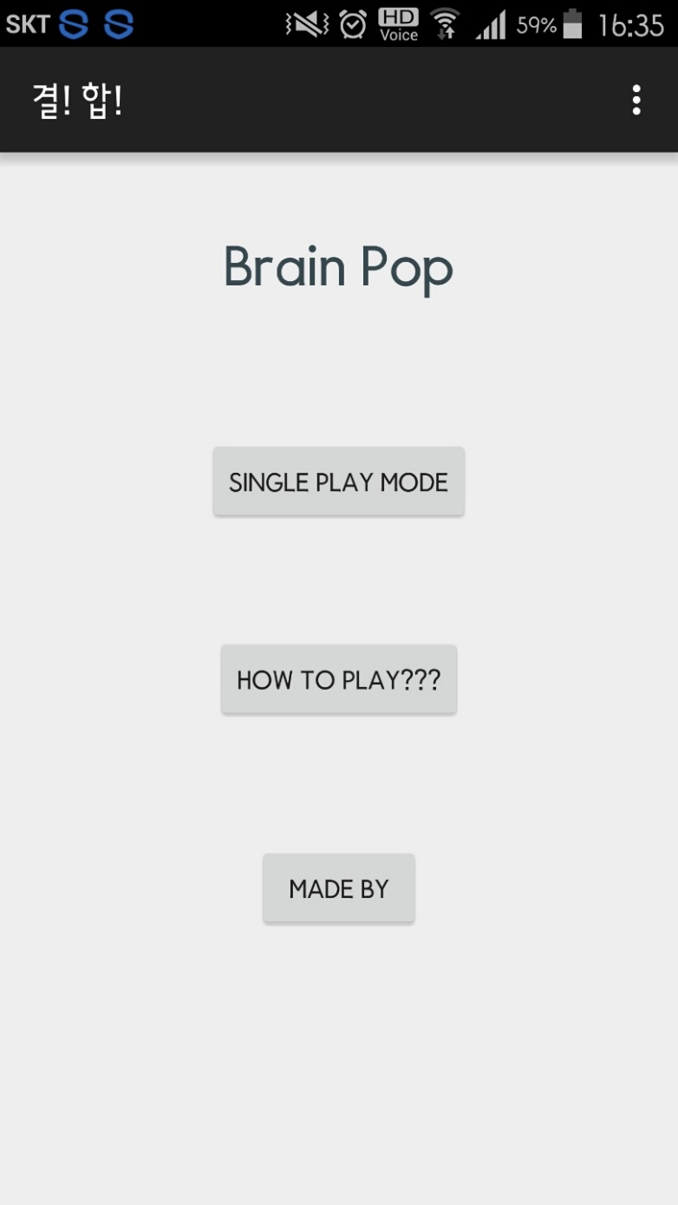

Slide 6
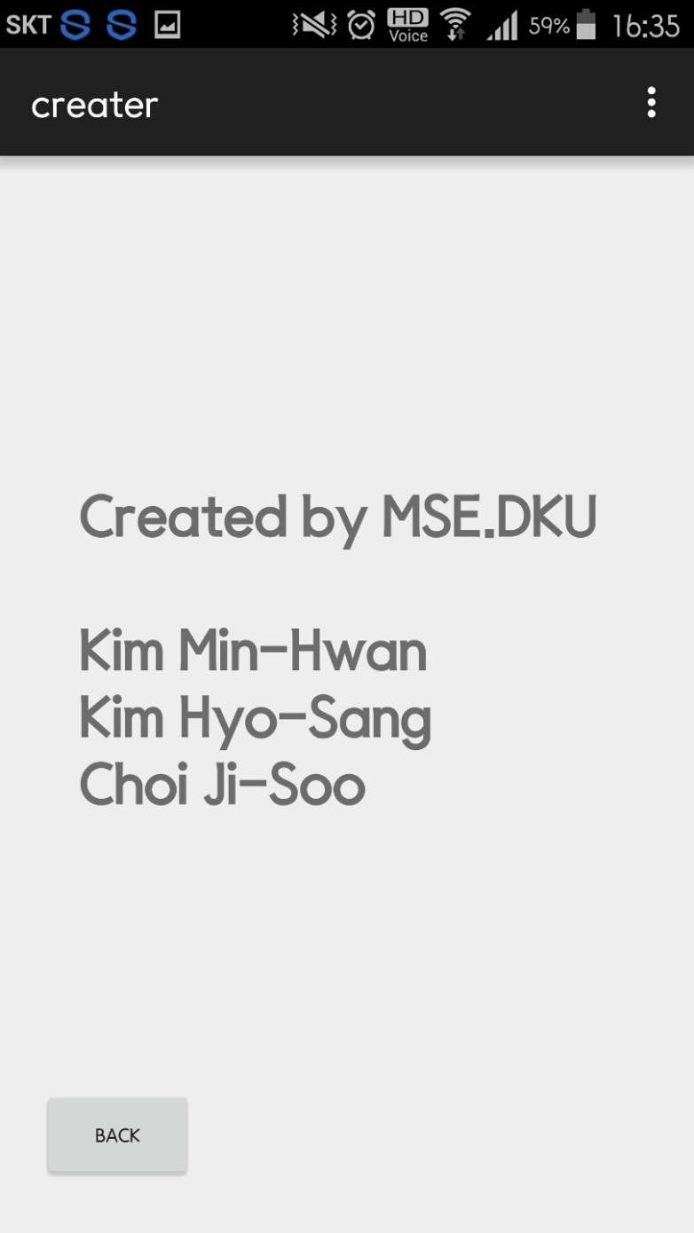

Slide 7
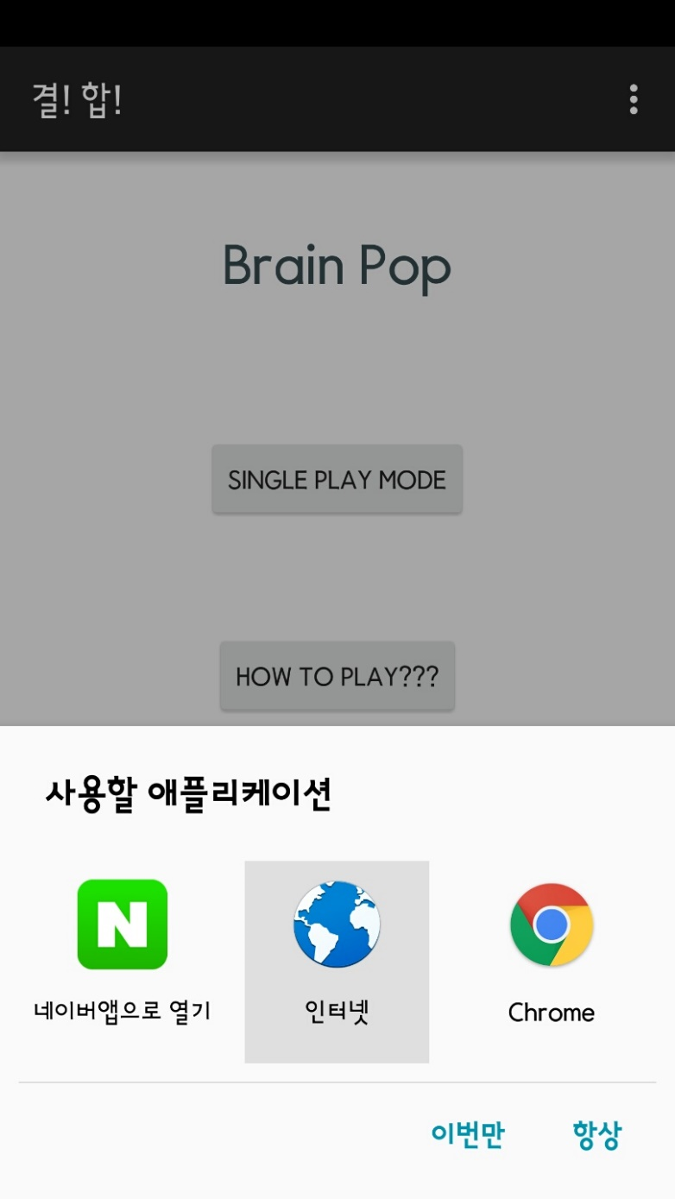


Slide 8
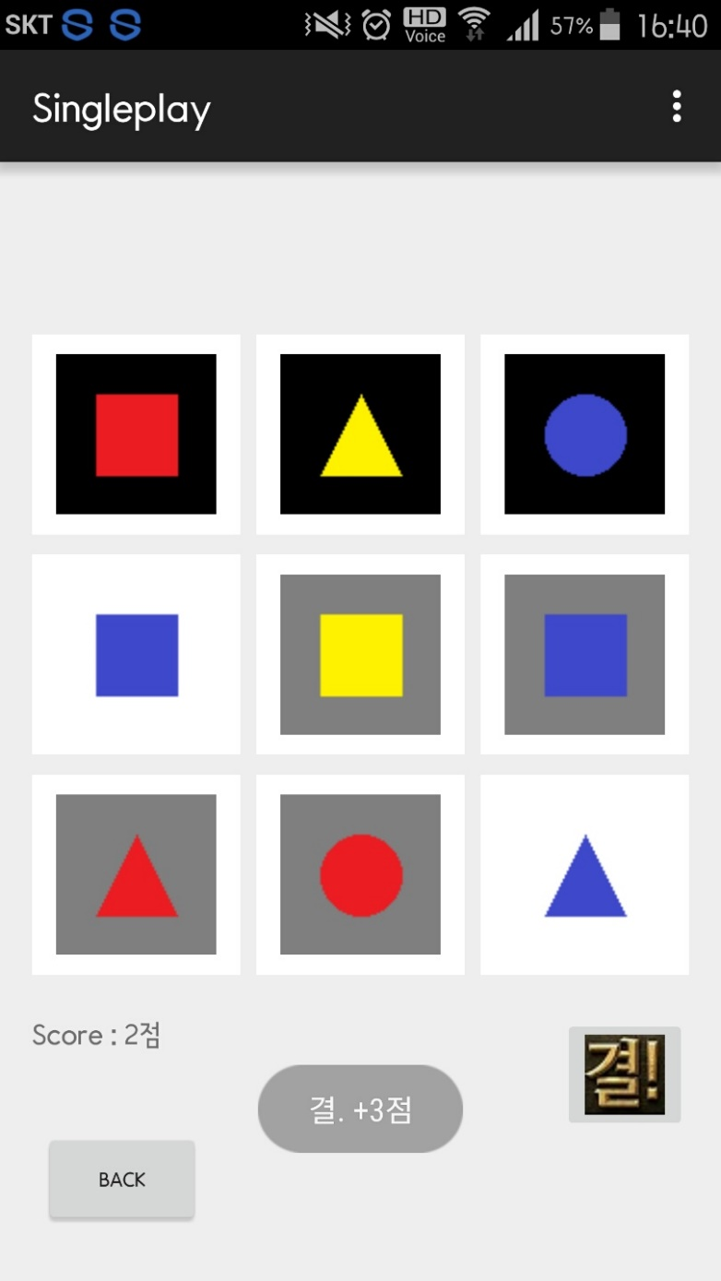
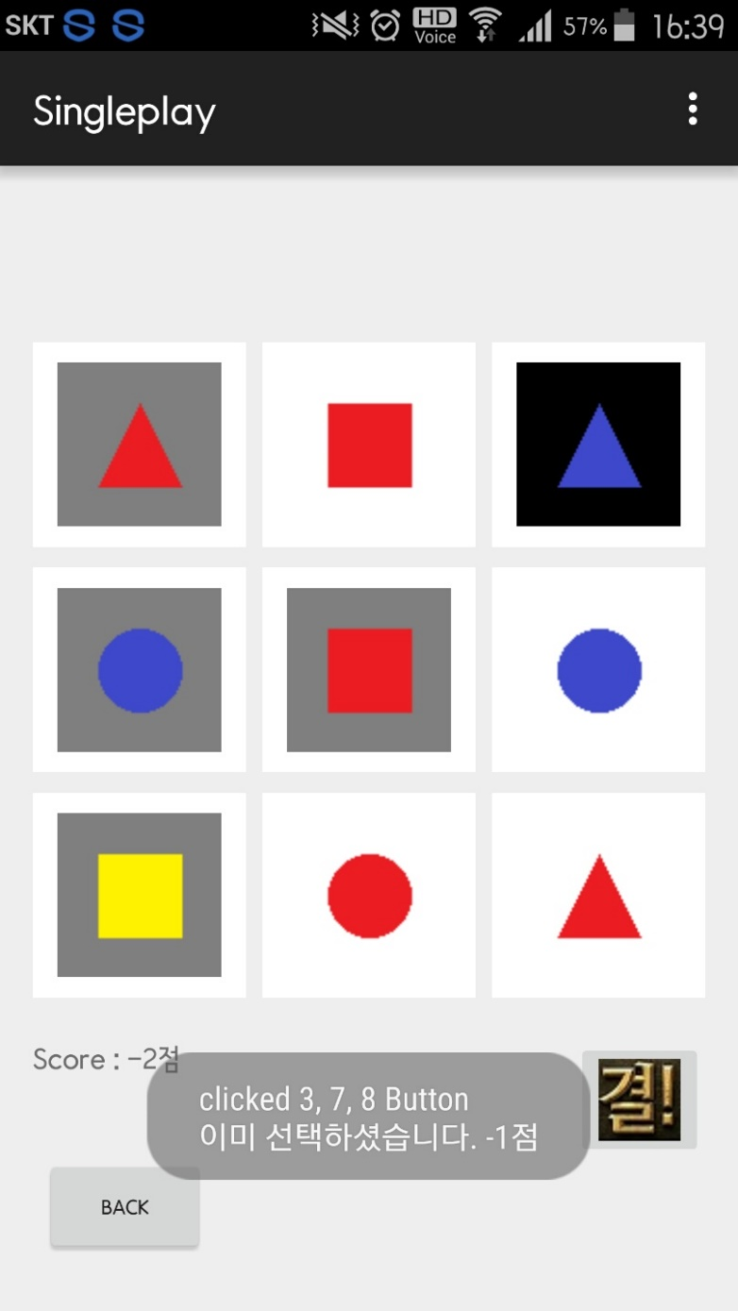
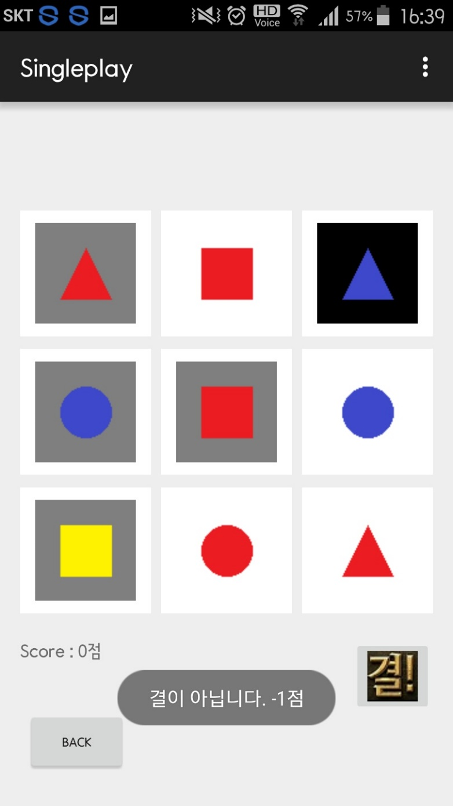
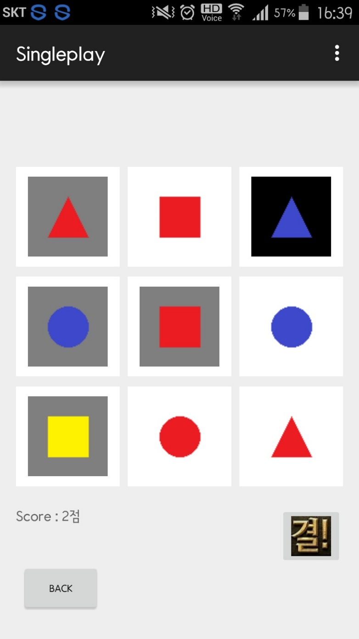
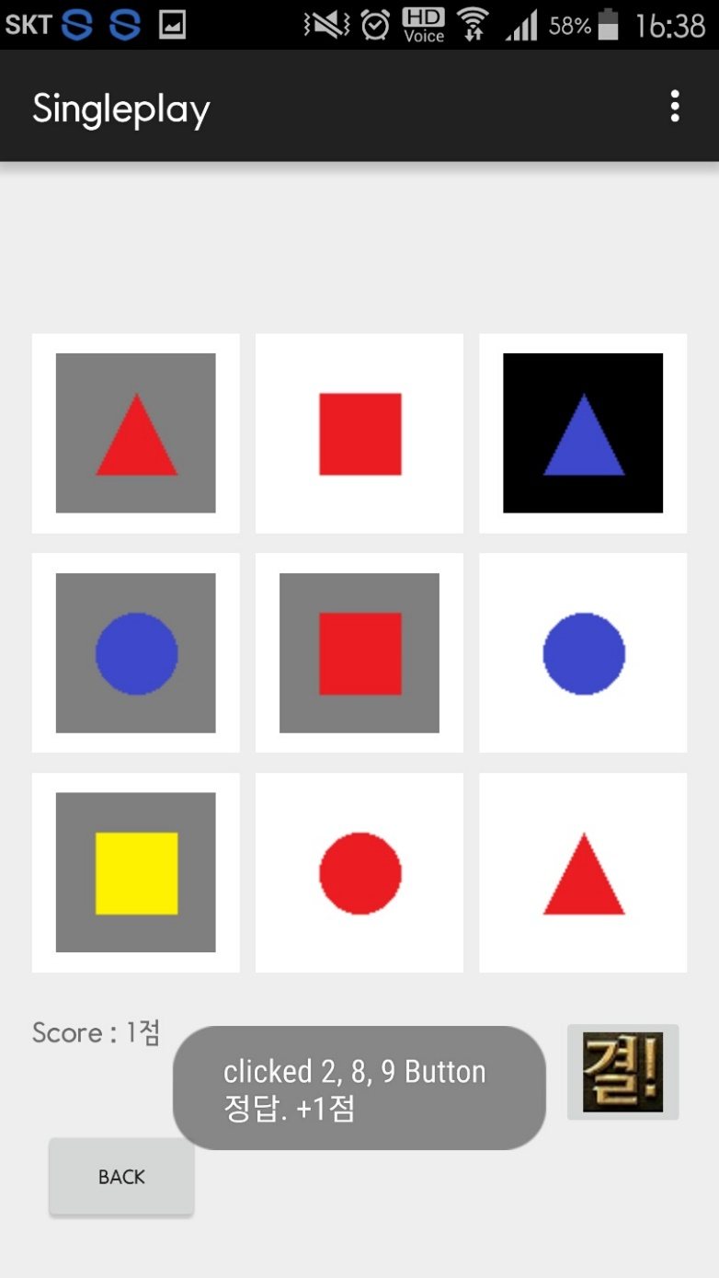


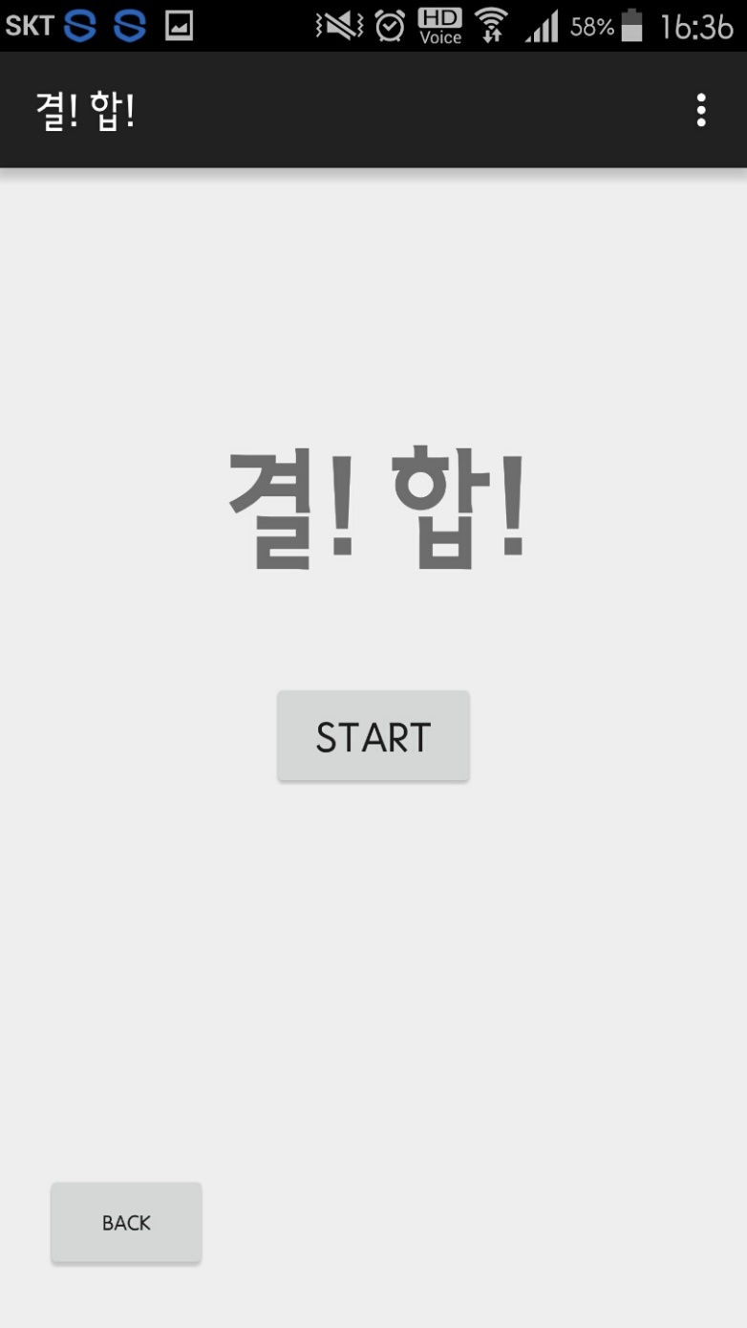

Slide 9
Class diagram

Slide 10
Thank you!!

